Slide 1
MEET THE MACHINES

Slide 2
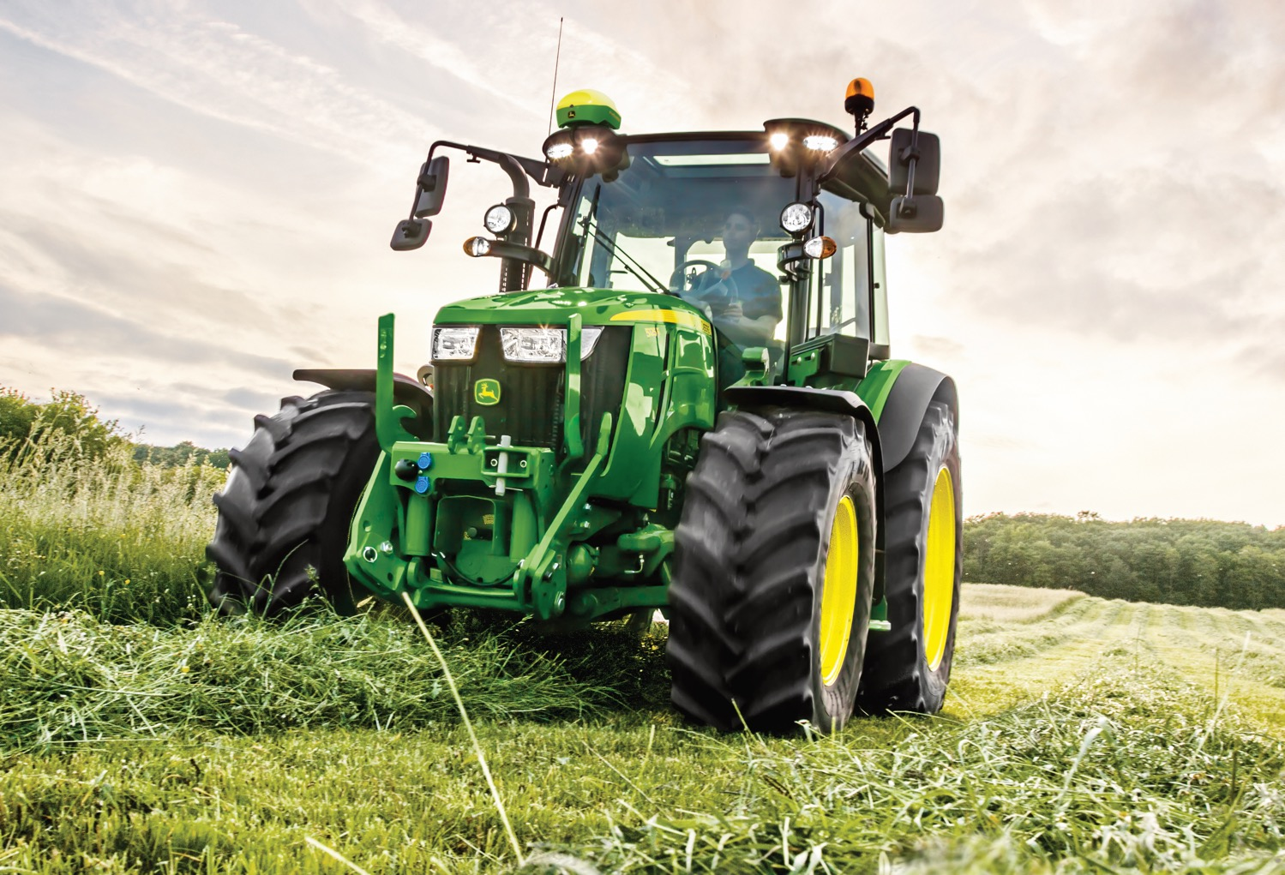
Notes:
A tractor is a machine that pulls other farming and construction equipment. Tractors were originally designed to replace animals, like horses, that pulled carts and plows.

Slide 3
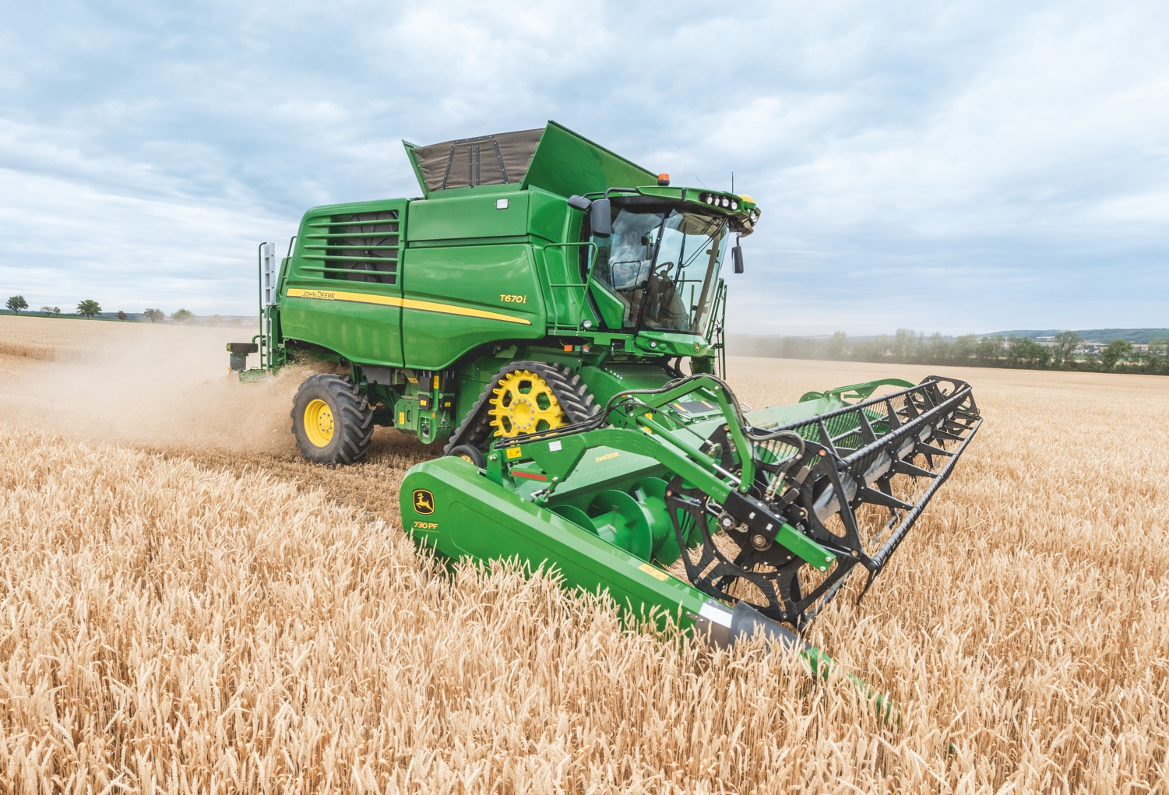
Notes:
A combine is a machine that helps farmers harvest grain crops, like wheat. It’s called a combine because it does three main jobs: cutting and gathering grain, shaking grain away from its stalks, and separating the grain.

Slide 4
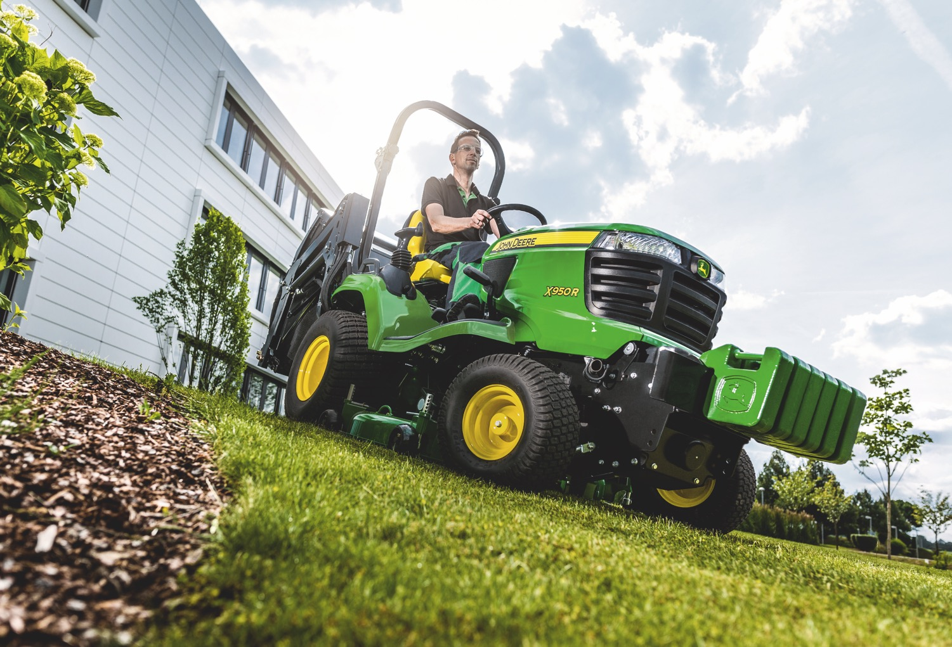
Notes:
A lawn tractor is a machine that helps people mow their grass. Lawn tractors can also be used for landscaping, yard work, and even snow removal.

Slide 5
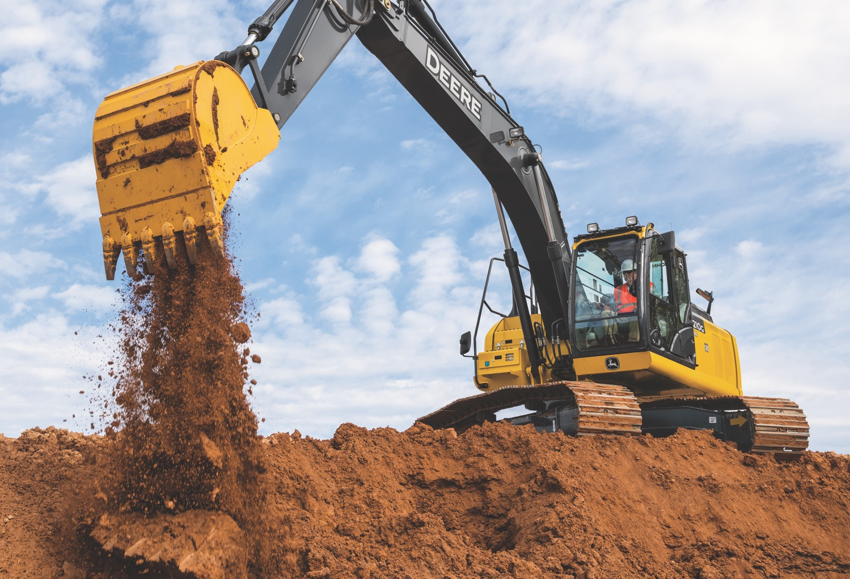
Notes:
An excavator is a machine that helps people dig up dirt and other materials. Farmers and construction workers use the bucket to scoop up dirt. Then, they rotate the machine to load the dirt into trucks.

Slide 6
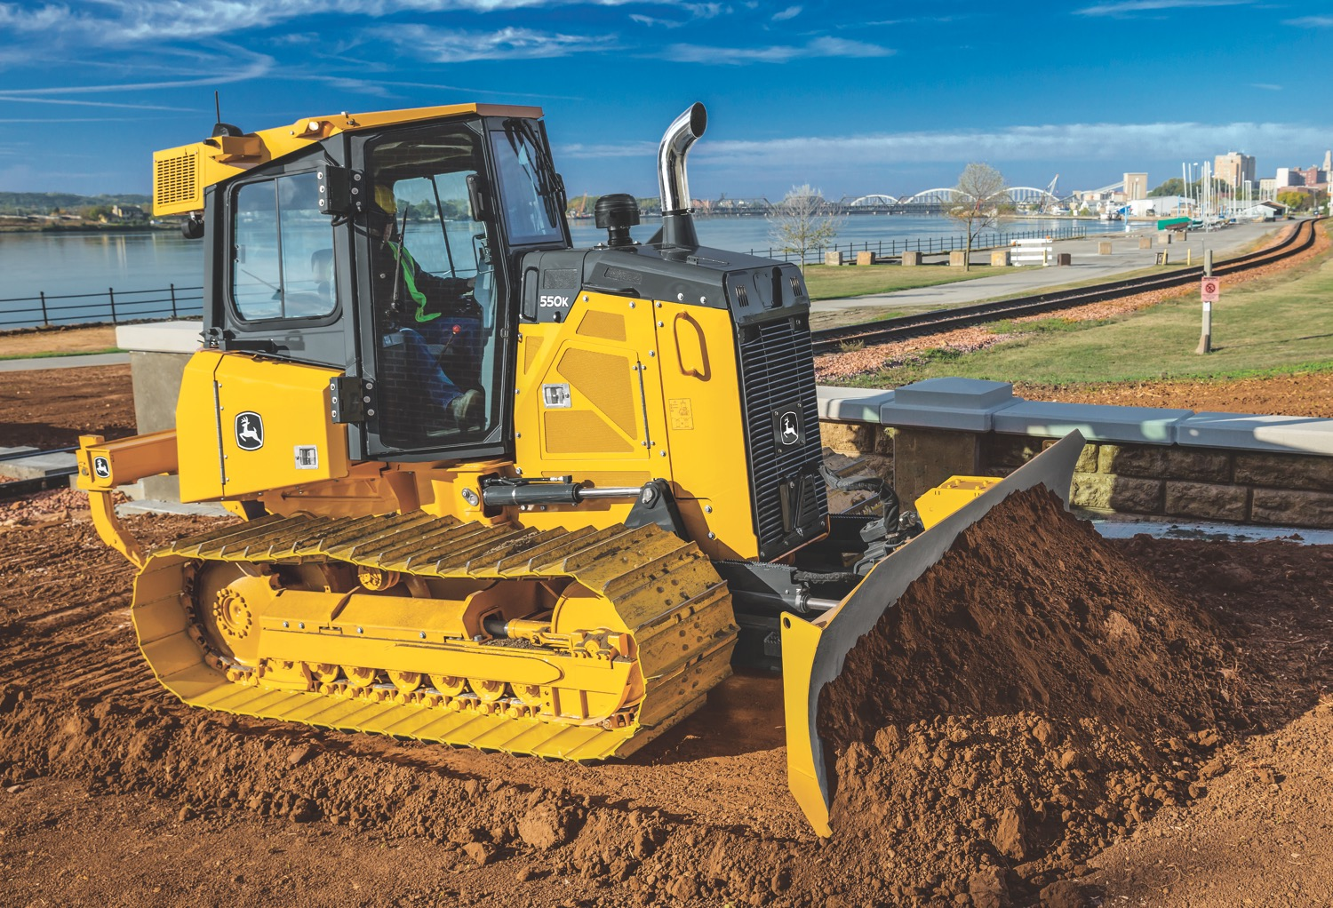
Notes:
A dozer is a machine that has a big metal blade on the front. Construction workers use that blade to push dirt, sand, and other materials around a jobsite. Dozers can also be used on farms, quarries, and even roads.

Slide 7
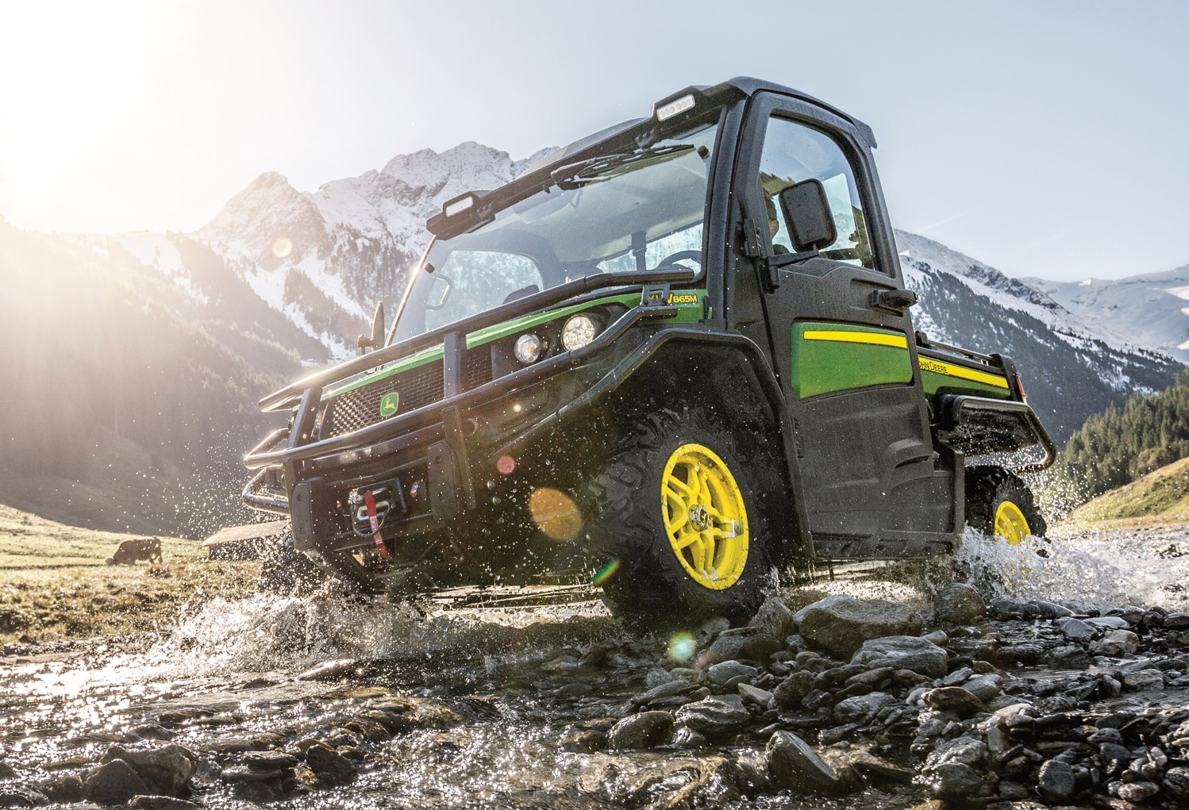
Notes:
A Gator™ is a machine that helps people haul materials over rocks, mud, and other rough terrain. Gators are often called utility vehicles. You can find these machines on farms, construction sites, golf courses, and other off-road environments.

Slide 8
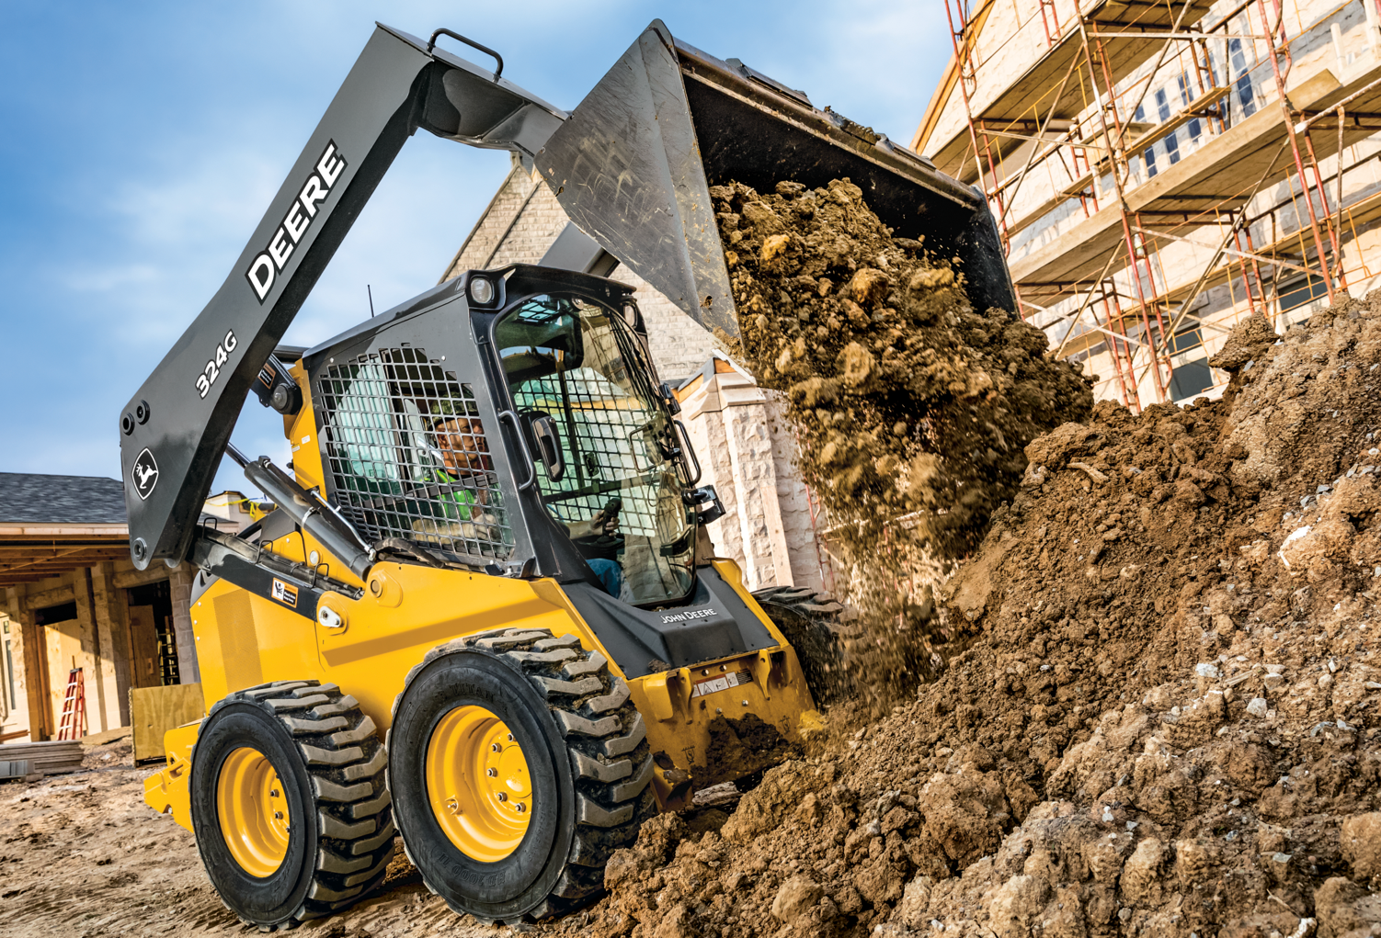
Notes:
A skid steer is a small machine with many uses, including digging, lifting, hauling, sweeping, plowing, and grinding. Farmers and construction workers can use different replaceable attachments, depending on what the job calls for.

Slide 9
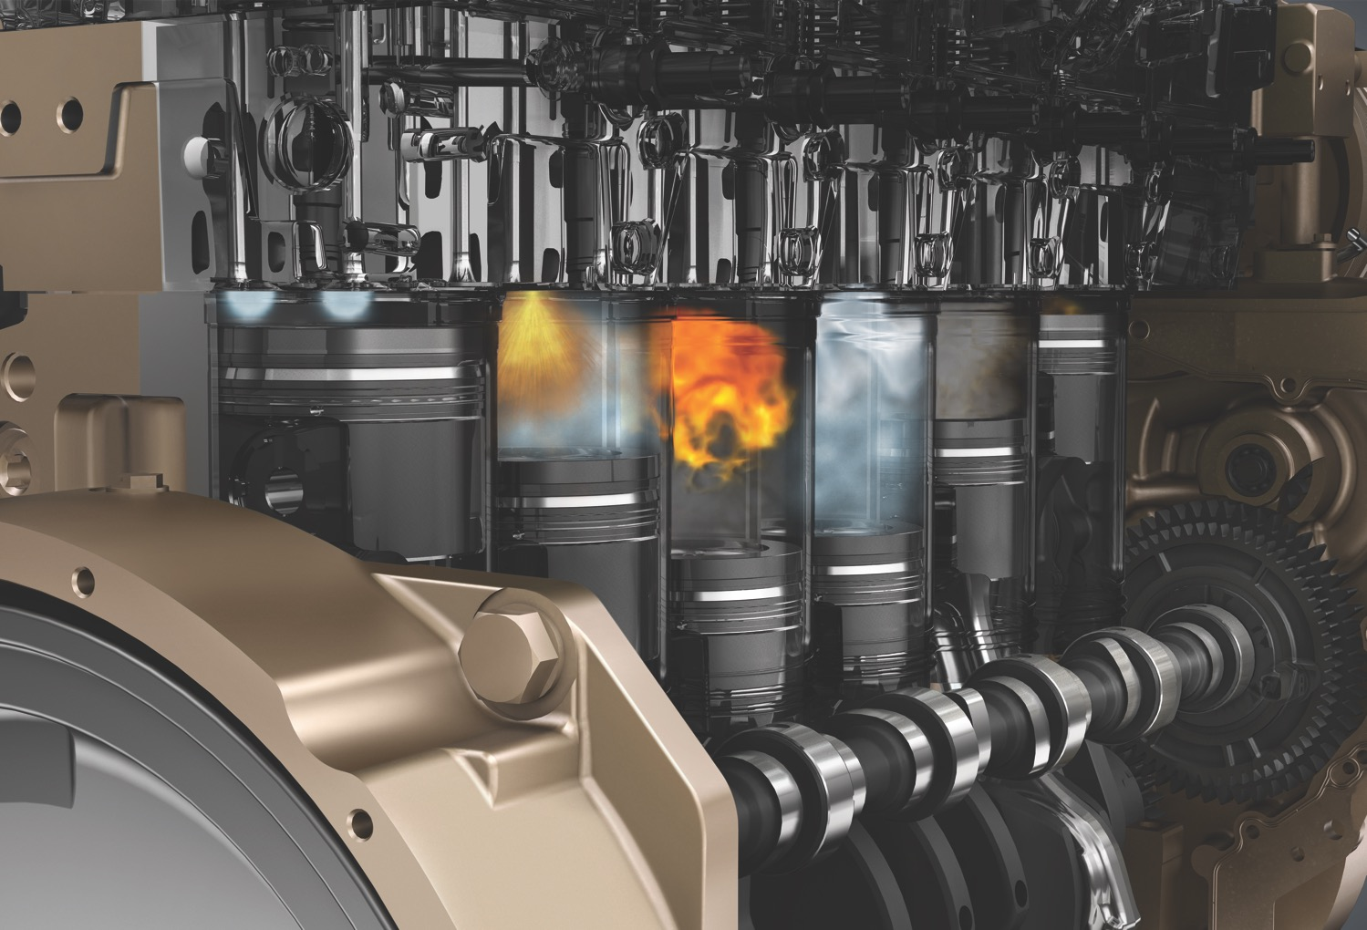
Notes:
Industrial engines help power other machines, like the ones we’ve explored in this activity. This is an example of an internal combustion engine, which means fuel is burned inside the main part of the engine to generate power.

Slide 10
